Slide 1
進度報告
Anti-spoofing

Slide 2
進度
增加新的dataset MSU-MFSD
Attack
觀察
下次進度

Slide 3
Attack 前情提要
Attack對象設定
只跑label是spoof且被test判別為spoof的frame
real被test判別為spoof的不會進行攻擊

Slide 4
OULU-1
Model
acc_mean | apcer | bpcer | acer
0.9591 | 0.1512 | 0.0128 | 0.0820
Attack
epsilon | 0.05 | 0.1 | 0.2 | 0.3 | 0.4 | 0.5 | 0.6 | 0.7 | 0.8 | 0.9
FGSM | 15.66 | 1.11 | 0 | 0 | 0.89 | 7.61 | 14.09 | 19.02 | 21.92 | 26.17
iFGSM | 36.91 | 30.20 |  | 46.98 | 49.44

Slide 5
OULU-2
Model
acc_mean | apcer | bpcer | acer
0.9430 | 0.0279 | 0.0715 | 0.04973
Attack
epsilon | 0.05 | 0.1 | 0.2 | 0.3 | 0.4 | 0.5 | 0.6 | 0.7 | 0.8 | 0.9
FGSM | 0 | 0 | 0 | 0 | 0 | 0 | 32.78 | 38.97 | 44.86 | 50
iFGSM | 34.74 | 29.31 |  | 69.03

Slide 6
OULU-3
Model
acc_mean | apcer | bpcer | acer
0.9274 | 0.0826 | 0.0339 | 0.0583
Attack
epsilon | 0.05 | 0.1 | 0.2 | 0.3 | 0.4 | 0.5 | 0.6 | 0.7 | 0.8 | 0.9
FGSM | 0 | 0 | 0 | 0 | 0.47 | 0.47 | 1.89 | 9.85 | 16.11 | 18.96
iFGSM | 23.22 | 21.32

Slide 7
OULU-4
Model
acc_mean | apcer | bpcer | acer
0.9815 | 0 | 0.0526 | 0.0263
Attack
epsilon | 0.05 | 0.1 | 0.2 | 0.3 | 0.4 | 0.5 | 0.6 | 0.7 | 0.8 | 0.9
FGSM | 2.85 | 0 | 0 | 0 | 5.71 | 11.42 | 11.42 | 11.42 | 11.42 | 11.42
iFGSM | 2.85 | 5.71 | 42.86 | 51.43 | 57.14

Slide 8
Replay Attack
Model
acc_mean | apcer | bpcer | acer
0.9125 | 0.025 | 0.1 | 0.0625
Attack
epsilon | 0.3 | 0.4 | 0.5 | 0.6
FGSM | 17.22 | 22.22 | 29.17 | 30.55
iFGSM |  |  | 98.06

Slide 9
CASIA
Model
acc_mean | apcer | bpcer | acer
0.9175 | 0.3016 | 0.0185 | 0.1601
Attack
epsilon | 0.3 | 0.4 | 0.5 | 0.6
FGSM | 0 | 45.75 | 93.40 | 95.28

Slide 10
image

Slide 11
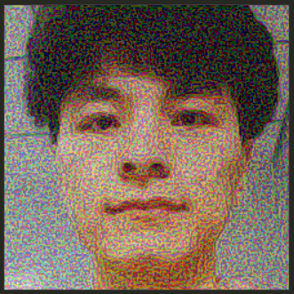
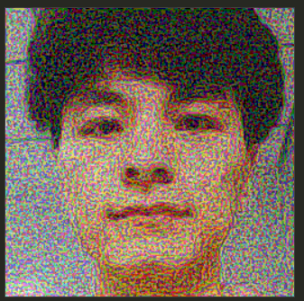


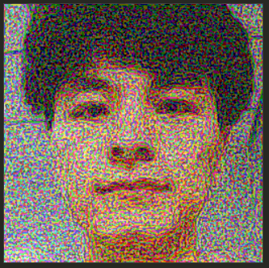
OULU
FGSM eps = 0.3
ASR = 0.0111
FGSM eps = 0.4
ASR = 0.0089
original
iFGSM eps = 0.3
ASR = 0.3020
FGSM eps = 0.5
ASR = 0.0761

Slide 12
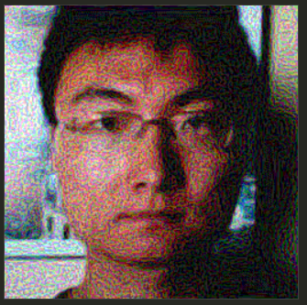
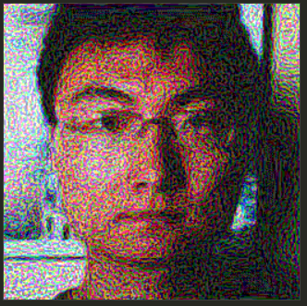

Replay Attack
FGSM eps = 0.3
ASR = 0.172
FGSM eps = 0.5
ASR = 0.2917
original

Slide 13
觀察
加夠多noise才攻擊得了
Eps極小時的異常現象
Performance iFGSM >> FGSM

Slide 14
下次進度
Attack new dataset MSU-MFSD
跑完實驗
在perturbation加各種filter(Gaussian)
Attack完後加各種filter(Gaussian)
改成其他用來攻擊的loss

